Slide 1
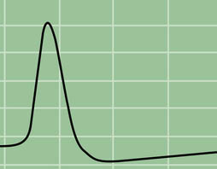
BMD ENG 301Quantitative Systems Physiology (Nervous System)
Lecture 9: Neural Signals
2022_v2
Professor Malcolm A. MacIver

Slide 2

Peace Sign
Designed by Gerald Holtom for the campaign for Nuclear Disarmament in 1958

Slide 3

N for Nuclear, D for Disarmament

Slide 4
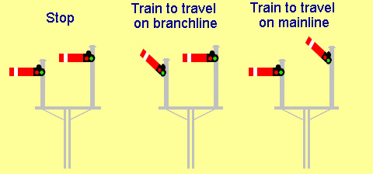
Railway Signals

Slide 5
How to think about computation in the brain
OLD THINKING: Codes (the “neural code”) sent between brain regions, where neuronal algorithms process the data to produce an output. Useful metaphor: a digital computer running an algorithm such as a digital motor speed governor, speed and voltage encoded as binary numbers
MORE RECENT THINKING: Signals are processed and outputs occur as a result of a (possibly high dimensional) continuous computation. Useful metaphor: the Watt governor

Slide 6
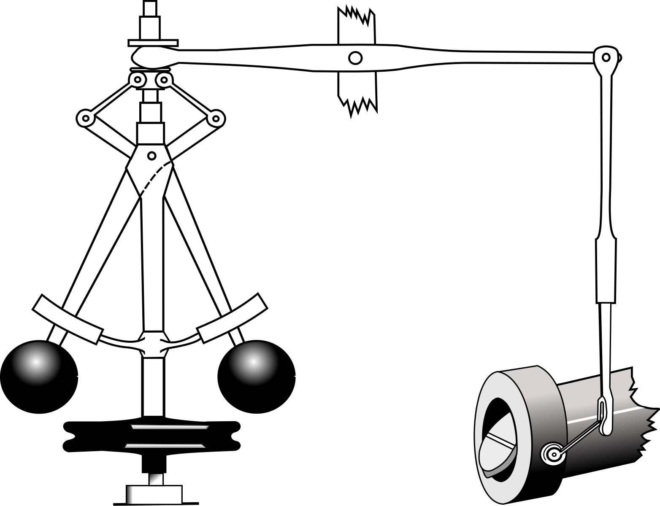
Digital computation
Analog computation
Algorithm for keeping a DC motor at the same revolutions per minute (RPM) as load varies, using a Hall Effect sensor on a flywheel attached to motor (note: In a DC motor, rotation speed is linear with input voltage):
1. Measure the rotations per minute (RPM)
2. Compare the RPM_actual to RPM_desired.
3. If there is no discrepancy, return to step 1. Otherwise,
a. measure the voltage going to motor;
b. calculate the RPM error
(RPM_desired - RPM_actual);
c. calculate the needed new voltage for zero RPM error.
4. Change the voltage to motor according to (3c).
Return to step 1.
Watt governor

Slide 7
The Electrical and the
Mechanical Hypotheses

Slide 8
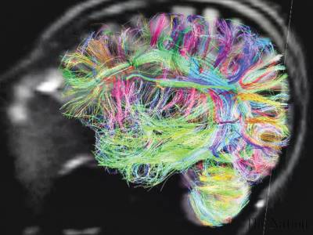
What is the Neural Code?

Slide 9
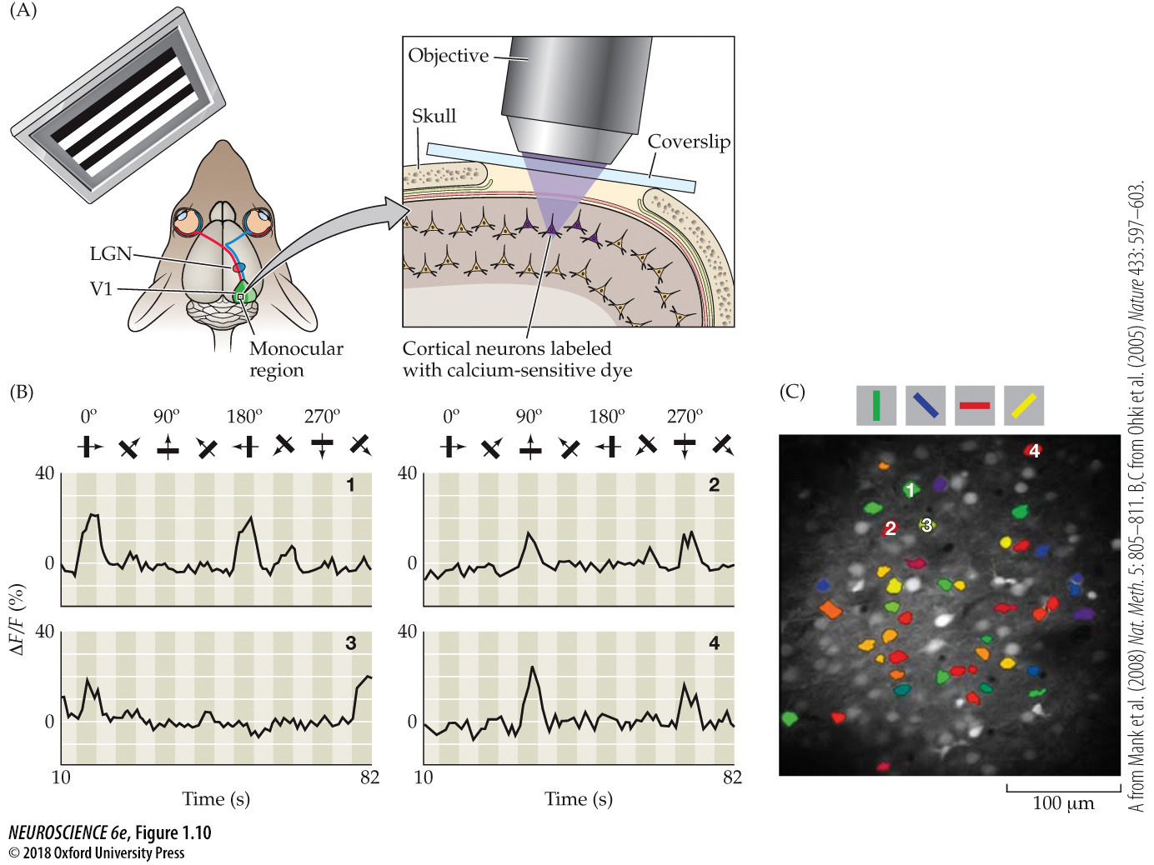
Imaging cortical neurons responding to visual stimuli using calcium-sensitive dyes
Notes:
Figure 1.10 Imaging cortical neurons responding to visual stimuli using calcium-sensitive dyes. (A) The imaging was done in a live mouse presented with visual stimuli at different orientations (a horizontally oriented series of high-contrast stripes is shown here). A small “window” of bone was removed over the visual cortex for application of the dyes and subsequent imaging; changes in fluorescence intensity were detected using a microscope with the objective over the exposed cortical surface. (LGN = lateral geniculate nucleus; V1 = primary visual cortex.) (B) The change in fluorescence intensity (∆ F/F [%]) of four cells imaged this way while the mouse viewed stripes in the orientations shown at the top of the graphs, moving in directions indicated by the arrows (numbers 1–4 on the graphs identify the cells, which can be localized in C). Each separate graph shows the response over time of one cortical cell. In each graph, the peaks in fluorescence signal indicate robust responses when the cell’s preferred stimulus orientation was presented; little response was elicited by nonpreferred stimuli. (C) The distribution of cells with preferred responses to stripes oriented at different angles (colors indicate preferred orientation). Activated cells preferring different orientations were interspersed, with each orientation represented by several cells in different positions within this small cortical area. (A from Mank, et al., 2008; B,C from Ohki et al., 2005.)

Slide 10
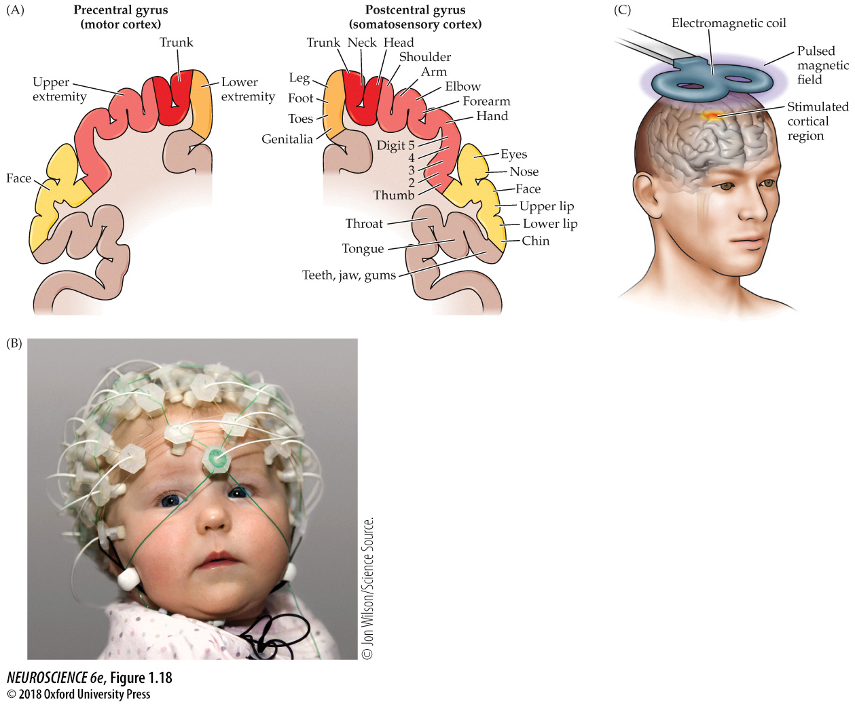
Indirect “images” of functional localization and maps using invasive and noninvasive neurophysiological approaches
Good temporal resolution
Notes:
Figure 1.18 Indirect “images” of functional localization and maps using invasive and noninvasive neurophysiological approaches. (A) Penfield and Jasper defined the homunculus using intracranial surface electrode mapping. This approach relied on stimulation using an electrode placed carefully on the arachnoid surface to avoid damage to the underlying brain tissue. This early work resulted in the somatotopic map, as represented here. (B) Event related potential (ERP) recording in an awake, alert child. The array of scalp electrodes in the “cap” indicates the recording locations. Comparing the response intensity recorded at each site provides a low-resolution map of localized cortical activity. (C) Transcranial magnetic stimulation (TMS) relies on a handheld device that generates a magnetic field based on current flow through a magnetic coil. The device can deliver a pulse of current to the surface of the cerebral cortex, causing a brief disruption of electrical activity in that area. TMS has gained some acceptance as a clinical treatment for depression and other mood disorders, as well as being used to assess normal function. (B © Jon Wilson/Science Source.)

Slide 11
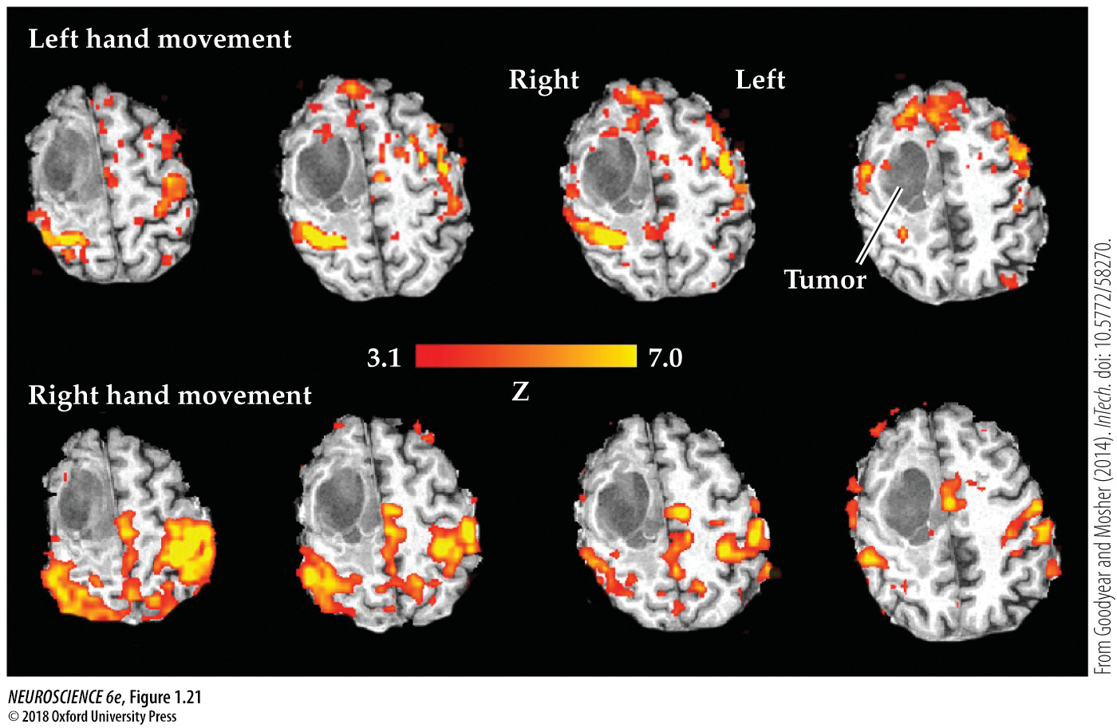
fMRI of a patient’s brain that harbored a right frontal lobe glioma (gray area)
Poor temporal resolution
Notes:
Figure 1.21 fMRI of a patient’s brain that harbored a right frontal lobe glioma (gray area). When asked to move the left hand, greater activity was observed within the right motor and sensorimotor cortices compared to the resting state. Since the activity was not close to the tumor, the surgeon could operate with assurance that the motor control of the hand would not be affected. Red-to-yellow indicates increasing relative strength of brain activity. (From Goodyear et al., 2014.)

Slide 12
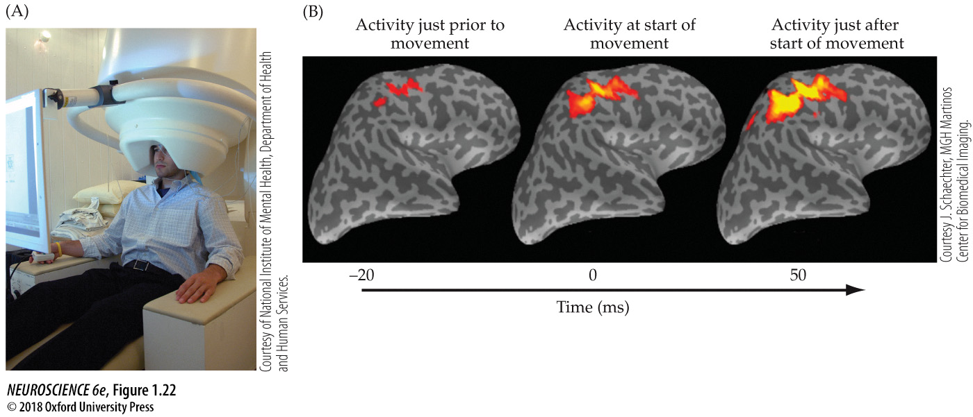
Magnetoencephalography (MEG) provides greater temporal resolution with useful spatial resolution
Notes:
Figure 1.22 Magnetoencephalography (MEG) provides greater temporal resolution with useful spatial resolution. (A) The individual is fitted with a helmet that includes several magnetic detectors (a SQUID array) and then is placed in a biomagnetometer (the large cylindrical structure) that can amplify the small local changes in magnetic field orientation or strength that indicate fast temporal current flow changes in ensembles of neurons. MEG, like MRI and fMRI, is noninvasive. (B) The temporal resolution of MEG permits millisecond resolution of electrical activity in the human brain before, during, and after performance of a variety of tasks (displayed in color over a structural MRI of the same brain that has been “inflated” to reveal cortex folded into sulci and fissures). In this case, a digit was moved in response to a specific sensory cue. There was some “anticipatory” activity in the region of the somatosensory as well as motor cortices where the digit was represented. As the movement began, this baseline activity increased so that a wider region of both the somatosensory and motor cortices was activated. As the movement proceeded, the activity increased over the time of performance. (A courtesy of National Institute of Mental Health, National Institutes of Health, Department of Health and Human Services; B courtesy of Judith Schaechter, PhD, MGH Martinos Center for Biomedical Imaging.)

Slide 13

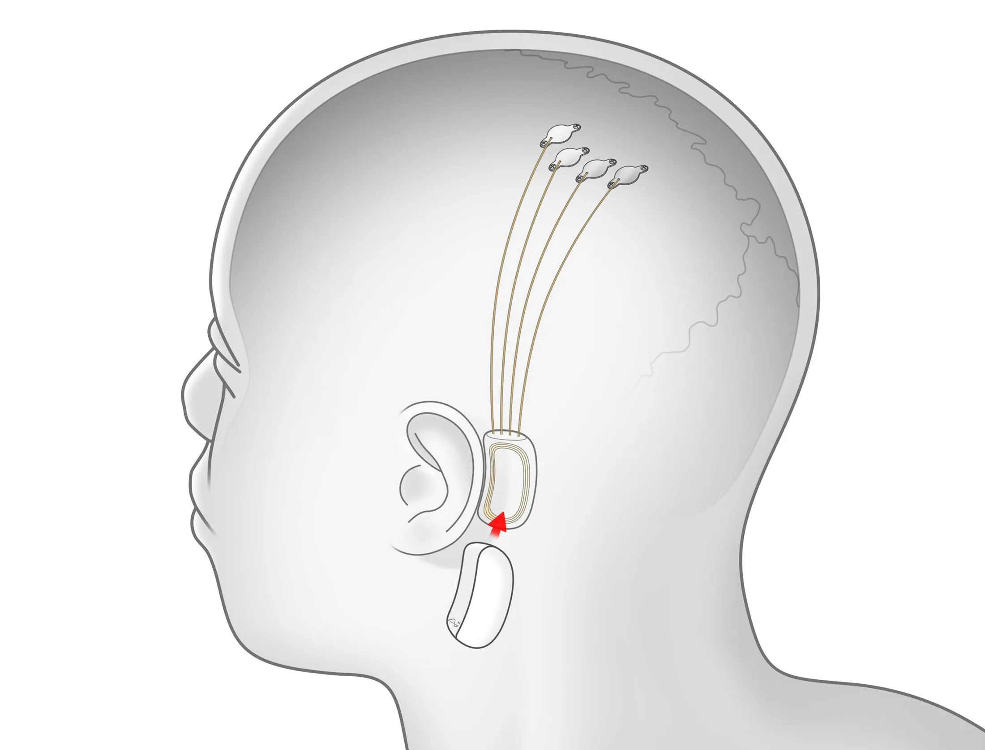
Why should we care?

Slide 14
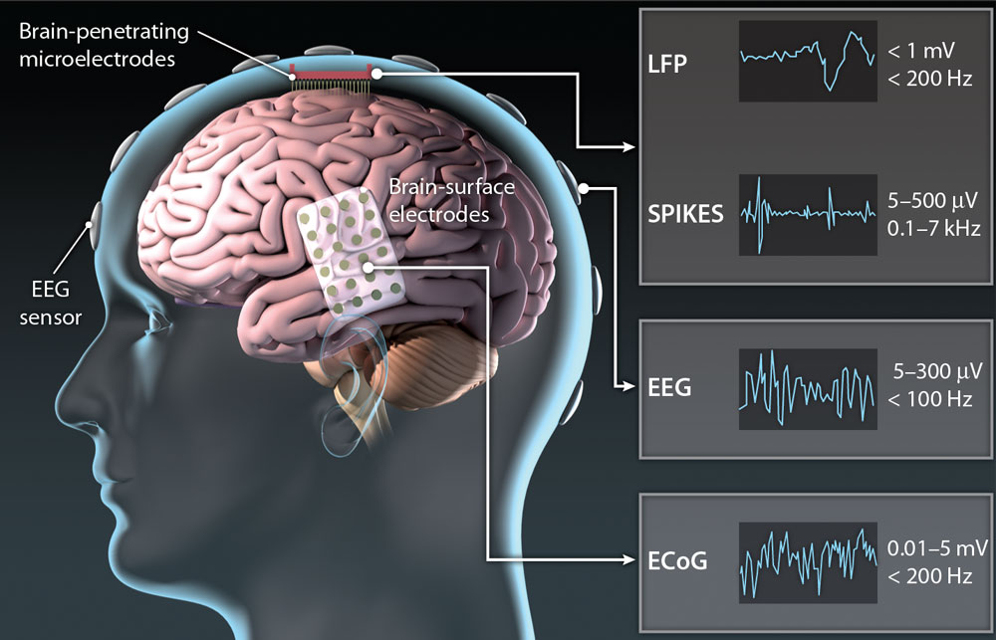
Why should we care?

Slide 15
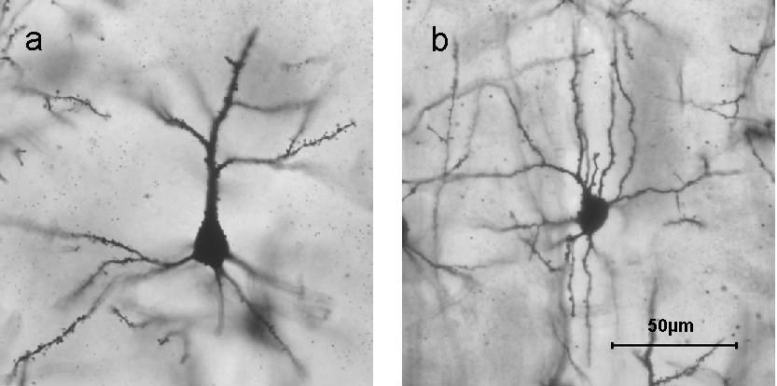
Cortical pyramidal and stellate cells
Neural signals at the single cell level

Slide 16
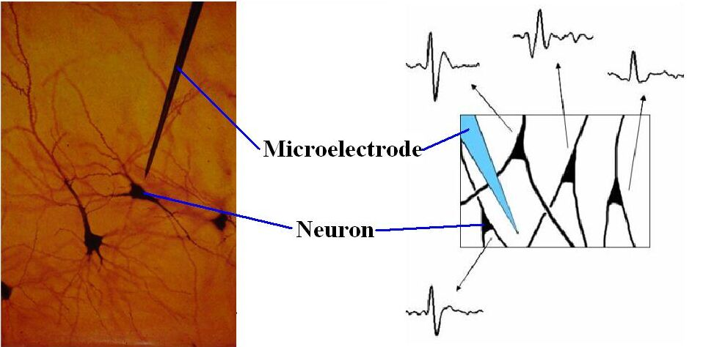
Extracellular Neural Recordings
Sub mV signals

Slide 17
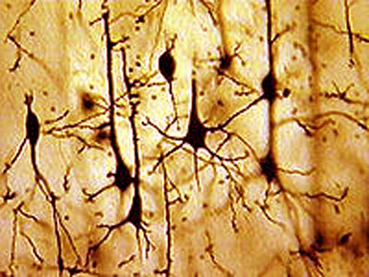
Spike (Action Potential) Sorting
Characterize the relation between stimuli and neural responses
The activity of neural ensembles is critical to understanding how information is coded, learned, processed, and retained by the nervous system
Notes:
Why do we do that?
Spike sorting characterize the relations between the stimulus and neural responses.
Also, the neural ensembles is important to understand how the brain manages the complex information well.

Slide 18

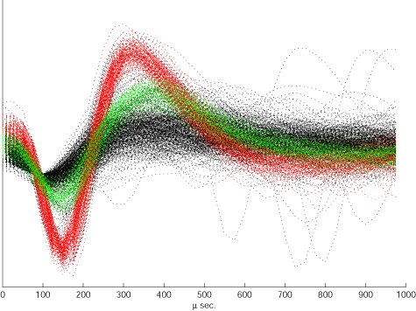
Neural Recordings
Neural signals are what we use to control neuroprostheses
If we do not understand what they mean to the brain how can we use them intelligently?
Notes:
Today, I will briefly talk about definition, and goal, challenges of spike sorting.
I will also explain basic steps and application of it.

Slide 19
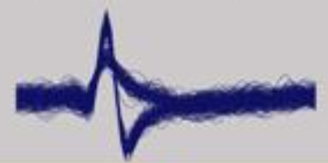
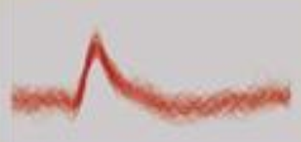

Basic Steps for Spike Sorting
Raw Data
Filtered Data
Spike Detection
Classification Algorithm

Slide 20
Sorting Based on Height
Relatively simple with pulse height analyzers
Notes:
Have been used in physics and electrical engineering before being applied in neurophysiology. Very cheap and easy
Second Figure: spontaneous activity of two different Purkinje cells from frog cerebellar cortex recorded extracellularly with the same electrode

Slide 21
Sorting Based on Shape
What if spikes have similar height?
Select features to analyze

Slide 22
Principal Component Analysis
Instead of selecting obvious features of the waves (height, width, max, min…) describe them as sum of weighted principal components
Analogous to Fourier Series approximation

Slide 23
Principal Component Analysis
Score is the “coefficient” of each principal component

Slide 24
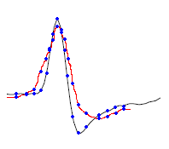
Template Matching
First choose a “standard” spike shape
Calculate the difference between a recorded spike and the “standard”
Add up the weighted differences at a number data points
“dissimilarity number”

Slide 25
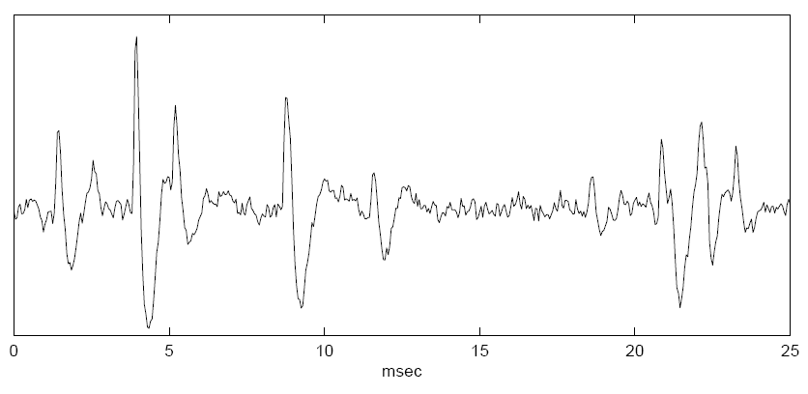
Overlapping Spikes
Problematic since superposition of spikes changes the shape of the signal
Occurs frequently
Example: Consider 3 neurons, each firing at 50 Hz with 1 ms pulse durations 15 superpositions per second
Algorithms to sort overlapped spikes:
Subtract a template from the superposition
Easiest, but only works when two spikes are separated enough to identify
Introduces more noise
Choose two templates and compare the recorded waveform with all possible combinations of two templates
Computationally Expensive

Slide 26
Recordings on Multiple Electrodes
More accurately sort multi-unit recordings
Analogous to having 2 ears
Single electrode algorithms can extend to multi-electrode recordings

Slide 27
Other Problems
Spikes are non-stationary
Noise is non-stationary
Electrode drift
Spike alignment

